Slide 1

IE 260 – ENGINEERING ECONOMY Chapter 10 Evaluating Projects with Benefit-Cost Ratio Method
U. MAHİR YILDIRIM

Slide 2
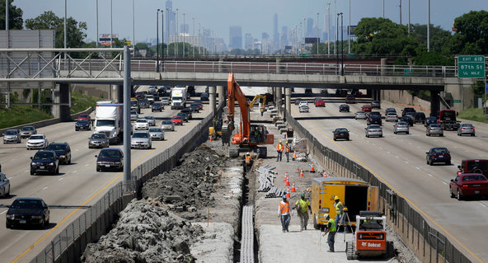

Chapter 10
The objective of Chapter 10 is to demonstrate the use of the benefit–cost (B–C) ratio for the evaluation of public projects.

Slide 3
Introduction
Public projects are those authorized, financed, and operated by governmental agencies*.
* a permanent or semi-permanent organization in the machinery of government that is responsible for the oversight and administration of specific functions, such as an T.C. Merkez Bankasi, Türkiye İstatistik Kurumu.

Slide 4
Introduction
Such public works are numerous, and although they may be of any size, they are frequently much larger than private ventures. Since they require the expenditure of capital, such projects are subject to the principles of engineering economy with respect to their design, acquisition, and operation.
Because they are public projects, however, a number of important special factors exist that are not ordinarily found in privately financed and operated businesses.

Slide 5
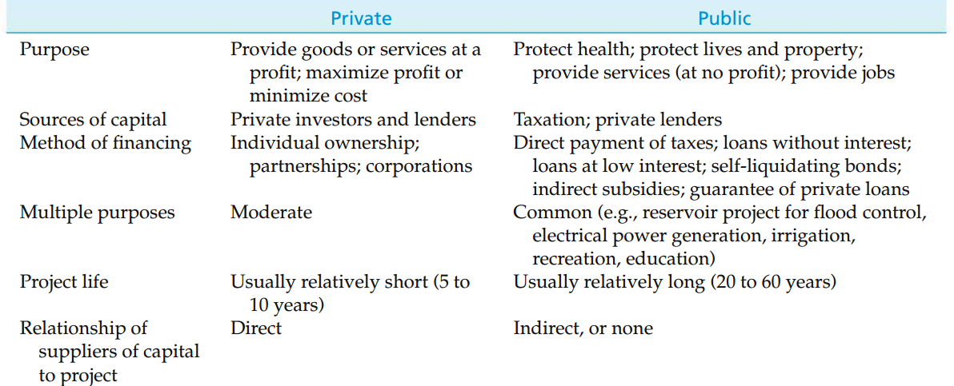
Some Basic Differences between Privately Owned and Publicly Owned Projects

Slide 6
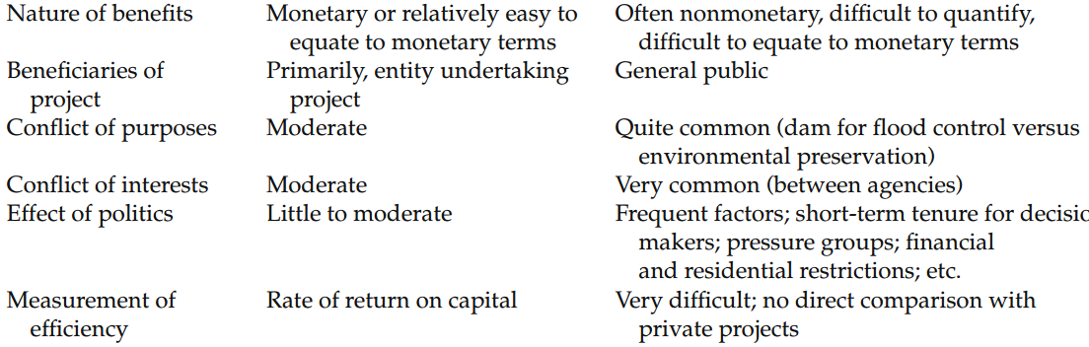
Some Basic Differences between Privately Owned and Publicly Owned Projects

Slide 7
Privately Owned vs Publicly Owned Projects
As a consequence of these differences, it is often difficult to make engineering economy studies and investment decisions for public-works projects in exactly the same manner as for privately owned projects.
Different decision criteria are often used, which creates problems for the public, for those who must make the decisions, and for those who must manage public-works projects.

Slide 8
Benefit–cost ratio method (B-C analysis)
B–C analysis is a systematic method of assessing the desirability of government projects or policies when it is important to take a long-term view of future effects and a broad view of possible side effects.
In meeting the requirements of this mandate, the B–C ratio method evolved into the calculation of a ratio of project benefits to project costs.
Rather than allowing the analyst to apply criteria more commonly used for evaluating private projects (IRR, PW, and so on), most governmental agencies require the use of the B–C method.

Slide 9
Perspective and Terminology for Analyzing Public Projects
Before applying the B–C ratio method to evaluate a public project, the appropriate perspective must be established.
In conducting an engineering economic analysis of any project, whether it is a public or a private undertaking, the proper perspective is to consider the net benefits to the owners of the enterprise considering the project.
This process requires that the question of who owns the project be addressed.

Slide 10

Who owns the project addressed?
Consider a project involving the expansion of a section of E-5 (D100) highway from three to four lanes.
Because the project is paid for primarily with funds channeled through the Department of Transportation, we might be inclined to say that the government is the owner.
These funds, however, originated from tax dollars—thus, the true owners of the project are the taxpayers.

Slide 11


Perspective and Terminology for Analyzing Public Projects
Project benefits are defined as the favorable consequences of the project to the public, but project costs represent the monetary disbursement(s) required of the government.
Considering again the widening of E-5 highway, some of the owners of the project would lose a portion of their land, along with a portion of their annual revenues.
The term disbenefits is generally used to represent the negative consequences of a project to the public.

Slide 12
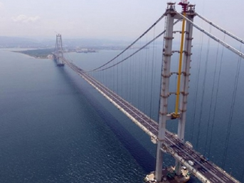
Self-Liquidating Projects
The term self-liquidating project is applied to a governmental project that is expected to earn direct revenue sufficient to repay its cost in a specified period of time. Example ?
Most of these projects provide utility services—for example, the fresh water, electric power, irrigation water, and sewage disposal provided by a hydroelectric dam.
Other examples of self-liquidating projects include toll bridges and highways.

Slide 13
Difficulties in Evaluating Public-Sector Projects
There is no profit standard to be used as a measure of financial effectiveness. Most public projects are intended to be nonprofit.
The monetary impact of many of the benefits of public projects is difficult to quantify.
There may be little or no connection between the project and the public, who is the owner of the project.
There is often strong political influence whenever public funds are used. When decisions regarding public projects are made by elected officials who will soon be seeking reelection, the immediate benefits and costs are stressed, often with little or no consideration for the more important long-term consequences.
immediate benefits vs long-term consequences

Slide 14
Difficulties in Evaluating Public-Sector Projects
Public projects are usually much more subject to legal restrictions than are private projects. For example, the area of operations for a municipally owned power company may be restricted such that power can be sold only within the city limits, regardless of whether a market for any excess capacity exists outside the city.
The ability of governmental bodies to obtain capital is much more restricted than that of private enterprises.
The appropriate interest rate for discounting the benefits and costs of public projects is often controversially and politically sensitive.

Slide 15

The Benefit−Cost Ratio Method
As the name implies, the B–C ratio method involves the calculation of a ratio of benefits to costs. Whether evaluating a project in the private sector or in the public sector, the time value of money must be considered to account for the timing of cash flows (or benefits) occurring after the inception of the project.
Thus, the B–C ratio is actually
a ratio of discounted benefits to discounted costs.
go/no-go decision

Slide 16
The Benefit−Cost Ratio Method
The B–C ratio is defined as the ratio of the equivalent worth of benefits to the equivalent worth of costs.
The equivalent-worth measure applied can be present worth, annual worth, or future worth, but customarily, either PW or AW is used.
The B–C ratio is also known as the savings-investment ratio (SIR) by some governmental agencies.

Slide 17
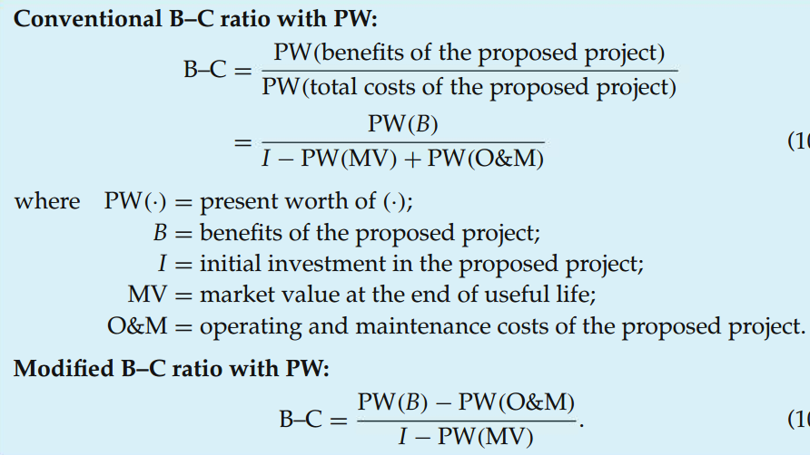
B-C Formulations - PW
When do we accept a project based on B-C ?
A project is acceptable when the B–C ratio is greater than or equal to 1.0

Slide 18
B-C Formulations - PW
the equivalent worth of the benefits minus the equivalent worth of the operating and maintenance costs
initial investment costs (less any market value)

Slide 19
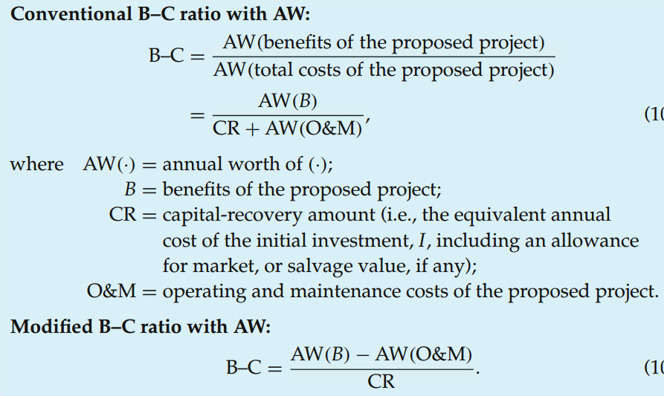
B-C Formulations - AW

Slide 20
B-C Formulations
The resulting B–C ratios for all the previous formulations will give identical results in determining the acceptability of a project (i.e., either B–C ≥ 1.0 or B–C < 1.0).
The conventional B–C ratio will give identical numerical results for both PW and AW formulations.
Similarly, the modified B–C ratio gives identical numerical results whether PW or AW is used.
Although the magnitude of the B–C ratio will differ between conventional and modified B–C ratios, go/no-go decisions are not affected by the choice of approach.
How come ?

Slide 21
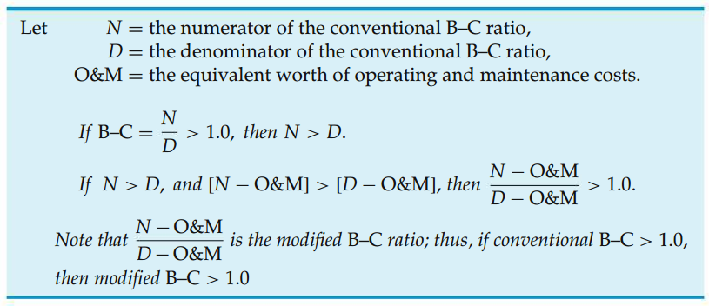
Equivalence of the B−C Ratio Formulations
vs

Slide 22
Example Equivalence of the B−C Ratio Formulations
The city of Columbia is considering extending the runways of its municipal airport so that commercial jets can use the facility. The land necessary for the runway extension is currently a farmland that can be purchased for $350,000. Construction costs for the runway extension are projected to be $600,000, and the additional annual maintenance costs for the extension are estimated to be $22,500. If the runways are extended, a small terminal will be constructed at a cost of $250,000. The annual operating and maintenance costs for the terminal are estimated at $75,000.

Slide 23
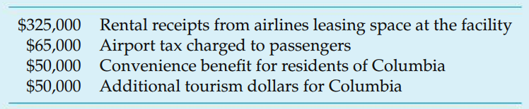
Example Equivalence of the B−C Ratio Formulations
Finally, the projected increase in flights will require the addition of two air traffic controllers at an annual cost of $100,000. Annual benefits of the runway extension have been estimated as follows:
Apply the B–C ratio method with a study period of 20 years and a MARR of 10% per year to determine whether the runways at Columbia Municipal Airport should be extended.

Slide 24
Example Equivalence of the B−C Ratio Formulations
The city of Columbia is considering extending the runways of its municipal airport so that commercial jets can use the facility. The land necessary for the runway extension is currently a farmland that can be purchased for $350,000. Construction costs for the runway extension are projected to be $600,000, and the additional annual maintenance costs for the extension are estimated to be $22,500. If the runways are extended, a small terminal will be constructed at a cost of $250,000. The annual operating and maintenance costs for the terminal are estimated at $75,000.
Finally, the projected increase in flights will require the addition of two air traffic controllers at an annual cost of $100,000. Annual benefits of the runway extension have been estimated as follows:
Apply the B–C ratio method with a study period of 20 years and a MARR of 10% per year to determine whether the runways at Columbia Municipal Airport should be extended.

Slide 25
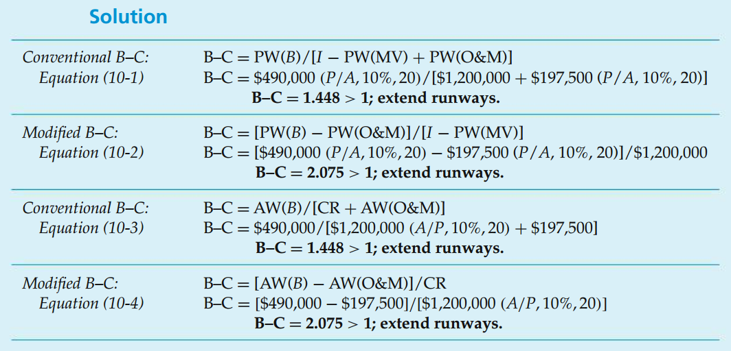
Solution Equivalence of the B−C Ratio Formulations

Slide 26

Example B-C Ratio of a Proposed Bypass
Two heavily travelled interstate highways currently intersect in the middle of a major metropolitan area. A 25-mile, four-lane bypass is being considered to connect the busy interstate highways at a point outside of the metropolitan area.
The projected construction cost of the bypass is $20 million. Annual maintenance of the roadway is expected to be $500,000. Major monetary benefits of reduced time delays due to traffic congestion, improved traveller safety (fewer traffic accidents), and expanded opportunities for commercial businesses are anticipated to be around $2 million per year.
If the study period is 50 years and the state’s interest rate is 8% per year, should the bypass be constructed? What impact does a social interest rate of 4% per year have on the B–C ratio of the project?

Slide 27

Solution B-C Ratio of a Proposed Bypass
At an interest rate of 8% per year, the conventional B–C ratio of the proposed bypass is
Because this ratio is less than one, the bypass is not economically acceptable at 8% interest.
If a social interest rate of 4% per year was used, the B–C ratio would be 1.40 and the bypass would be acceptable.

Slide 28
Disbenefits in the B−C Ratio
Disbenefits
Negative consequences to the public resulting from the implementation of a public-sector project.

Slide 29
Disbenefits in the B−C Ratio (cont'd)
The traditional approach for incorporating disbenefits into a B–C analysis is to reduce benefits by the amount of disbenefits
(i.e., to subtract disbenefits from benefits in the numerator of the B–C ratio)
Alternatively, the disbenefits could be treated as costs
(i.e., add disbenefits to costs in the denominator).

Slide 30
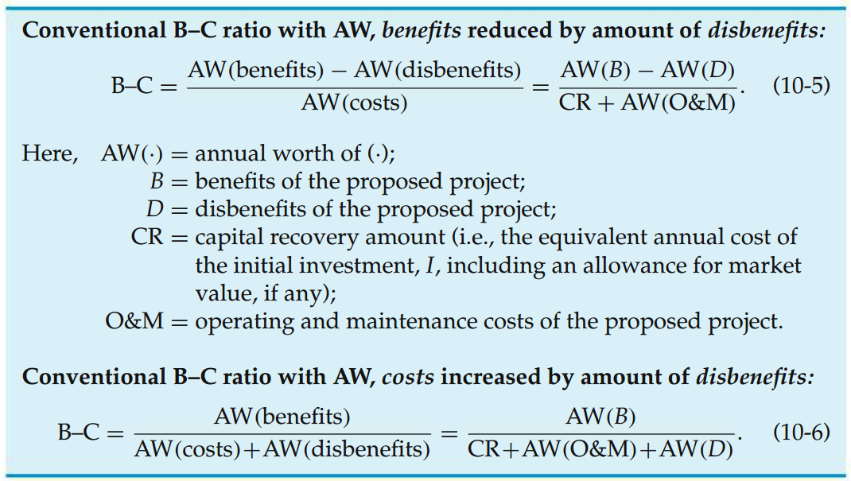
Disbenefits in the B−C Ratio
reduce benefits by the amount of disbenefits
treat disbenefits as costs

Slide 31
Example Including Disbenefits in a B−C Analysis
Refer back to the runway example where annual benefit was $490,000, initial investment was $1.2M and annual cost was $197,500.
In addition to the benefits and costs, suppose that there are disbenefits associated with the runway extension project. Specifically, the increased noise level from commercial jet traffic will be a serious nuisance to homeowners living along the approach path to the Columbia Municipal Airport. The annual disbenefit to citizens of Columbia caused by this noise pollution is estimated to be $100,000.
Given this additional information, reapply the conventional B–C ratio, with equivalent annual worth, to determine whether this disbenefit affects your recommendation on the desirability of this project.

Slide 32
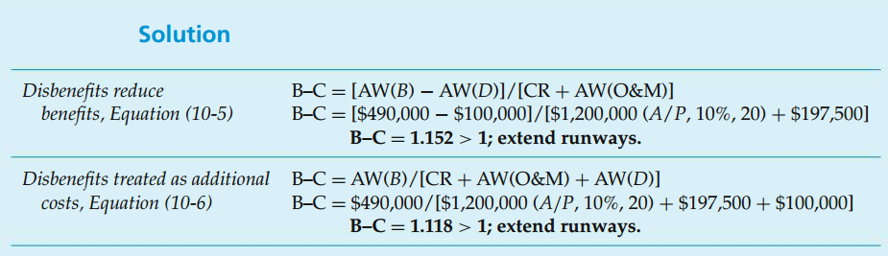
Solution Including Disbenefits in a B−C Analysis

Slide 33
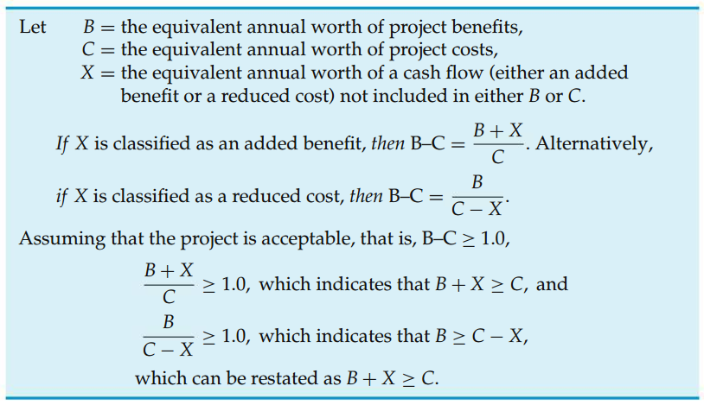
Added Benefits versus Reduced Costs in B−C Analyses
The magnitude of the calculated B–C ratio will be affected, but it will have no effect on project acceptability.

Slide 34
A Real-Life Case
http://dergipark.gov.tr/download/article-file/215697
In this study, a Urban Information Systems (UIS) design for Denizli Municipal has been carried out. In the design; project planning, selection of software and hardware, database design, data collection, data storage and testing of the system and its application have been done. As a result, Benefit-Cost analysis has been concretely argued.

Slide 35
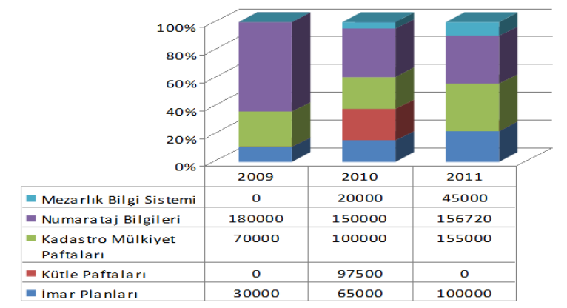
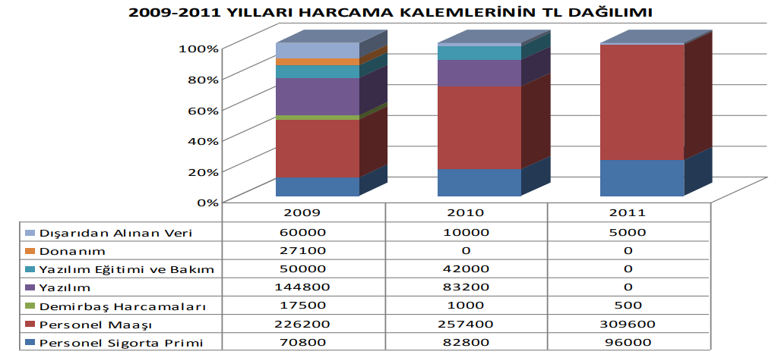
A Real-Life Case (cont'd)
The items benefit TL distribution of the period of 2009-2011
The items expenditure TL distribution of the period 2009-2011

Slide 36
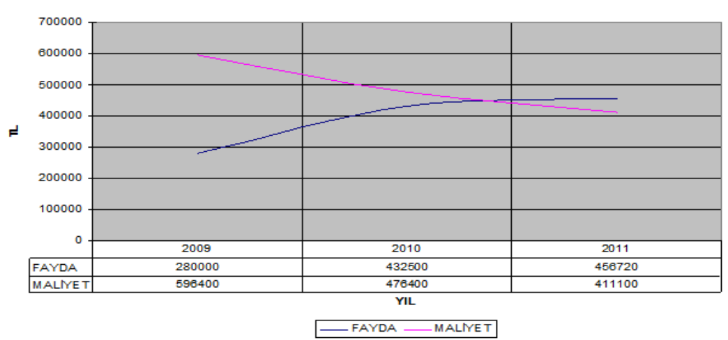
A Real-Life Case (cont'd)

Slide 37
Comparison of Mutually Exclusive Projects by B−C Ratios
Selecting the project that maximizes the B–C ratio ?
does not guarantee that the best project is selected.
As with the rate-of-return procedures in Chapter 6, an evaluation of mutually exclusive alternatives by the B–C ratio requires that an incremental B–C analysis be conducted.

Slide 38
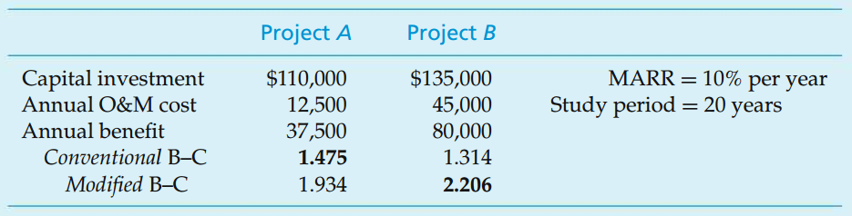
Example Inconsistent Ranking Problem When B−C Ratios Are Inappropriately Compared
Note that Project A has the greater conventional B–C, but Project B has the greater modified B–C.
Although each of the B–C ratios shown is numerically correct, a comparison of mutually exclusive alternatives requires that an incremental analysis be conducted.

Slide 39
Comparing mutually exclusive alternatives with the B–C ratio method
Alternatives are ranked in order of increasing total equivalent worth of costs
The do-nothing alternative is selected as a baseline alternative.
The B–C ratio is then calculated for the alternative having the lowest equivalent cost.
If the B–C ≥ 1.0, then that alternative becomes the new baseline; otherwise, do-nothing remains as the baseline.
The next least equivalent cost alternative is then selected, and the difference in the respective benefits and costs of this alternative and the baseline is used to calculate an incremental B–C ratio
If that ratio ≥ 1.0, then the higher equivalent cost alternative becomes the new baseline; otherwise, the last baseline alternative is maintained.
Incremental B–C ratios are determined for each successively higher equivalent cost alternative until the last alternative has been compared.

Slide 40
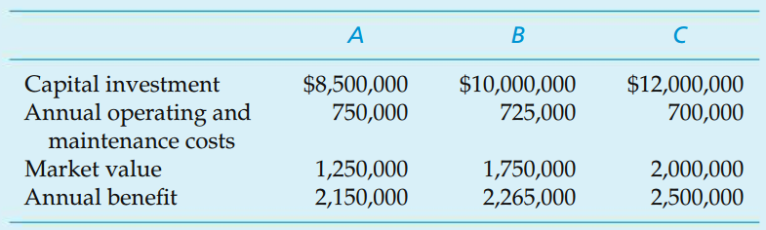
Example Incremental B−C Analysis of Mutually Exclusive Projects
Three mutually exclusive alternative public-works projects are currently under consideration. Their respective costs and benefits are included in the table that follows. Each of the projects has a useful life of 50 years, and MARR is 10% per year. Which, if any, of these projects should be selected?

Slide 41
Example
Each of the projects has a useful life of 50 years, and MARR is 10% per year. Which, if any, of these projects should be selected?
Alternatives are ranked in order of increasing total equivalent worth of costs
The do-nothing alternative is selected as a baseline alternative.
The B–C ratio is then calculated for the alternative having the lowest equivalent cost.
If the B–C ≥ 1.0, then that alternative becomes the new baseline; otherwise, do-nothing remains as the baseline.
The next least equivalent cost alternative is then selected, and the difference in the respective benefits and costs of this alternative and the baseline is used to calculate an incremental B–C ratio
If that ratio ≥ 1.0, then the higher equivalent cost alternative becomes the new baseline; otherwise, the last baseline alternative is maintained.
Incremental B–C ratios are determined for each successively higher equivalent cost alternative until the last alternative has been compared.

Slide 42
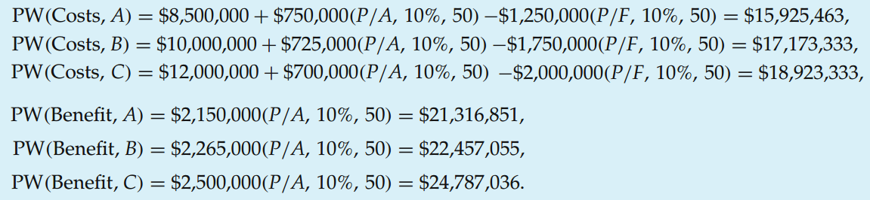
Solution Incremental B−C Analysis of Mutually Exclusive Projects

Slide 43
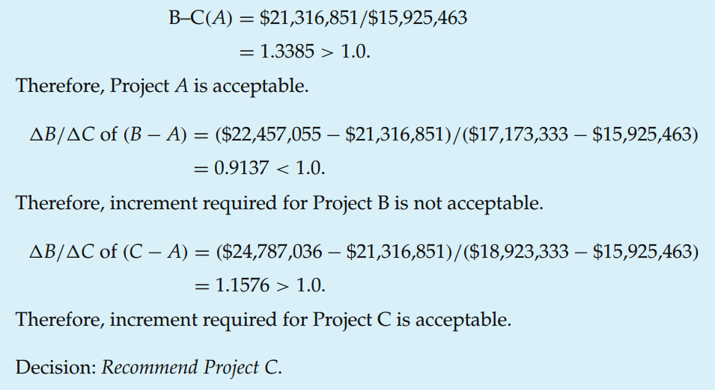
Solution Incremental B−C Analysis of Mutually Exclusive Projects

Slide 44
Example 2 Incremental B−C Analysis of Mutually Exclusive Projects
There are four mutually exclusive alternatives for a public project. Select the best alternative using incremental B/C ratio analysis if interest rate is 7% per year. The cash flow details of the alternatives are shown in the following table. Each alternative has the useful life of 40 years.
 | A1 | A2 | A3 | A4
Initial Investment | 101.000 M | 112.000 M | 145.200 M | 122.800 M
Annual Operating and Maintenance Cost | 6.700 M | 6.450 M | 5.780 M | 6.135 M
Annual Benefits | 16.420 M | 17.200 M | 19.100 M | 17.900 M
(P/A, 7%, 40) = 13.3317

Slide 45
Solution 2 Incremental B−C Analysis of Mutually Exclusive Projects
PW of costs of A1 = 101,000,000 + 6,700,000 X 13.3317 PW of costs of A1 = 190,322,390
PW of costs of A2 = 112,000,000 + 6,450,000 X 13.3317 PW of costs of A2 = 197,989,465
PW of costs of A3 = 145,200,000 + 5,780,000 X 13.3317 PW of costs of A3 = 222,257,226
PW of costs of A4 = 122,800,000 + 6,135,000 X 13.3317 PW of costs of A4 = 204,589,980

Slide 46
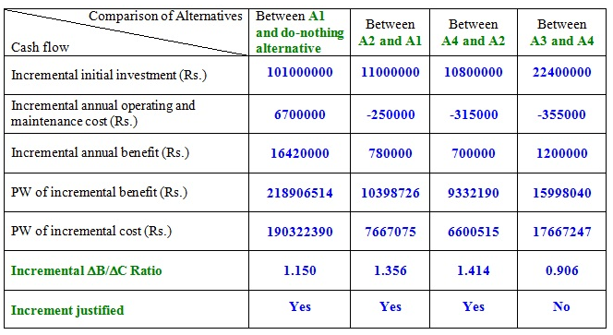
Solution 2 (cont'd) Incremental B−C Analysis of Mutually Exclusive Projects

Slide 47
B−C Analysis with Unequal Project Lives
It is not uncommon for some of the projects in a set of mutually exclusive public-works projects to have different lives.
Recall from Chapter 6 that the AW criterion can be used to select from among alternatives with different lives as long as the assumption of repeatability is valid.
Similarly, if a mutually exclusive set of public-works projects includes projects with varying useful lives, it may be possible to conduct an incremental B–C analysis by using the AW of benefits and costs of the various projects

Slide 48
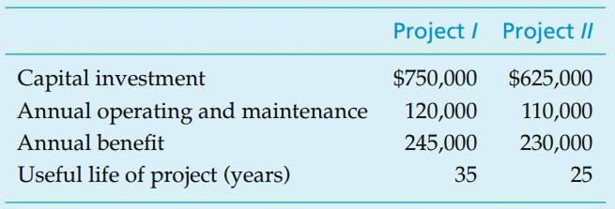
Example B−C Analysis with Unequal Project Lives
Two mutually exclusive alternative public-works projects are under consideration. Their respective costs and benefits are included in the table that follows. Project I has an anticipated life of 35 years, and the useful life of Project II has been estimated to be 25 years. If the MARR is 9% per year, which, if either, of these projects should be selected? The effect of inflation is negligible.

Slide 49
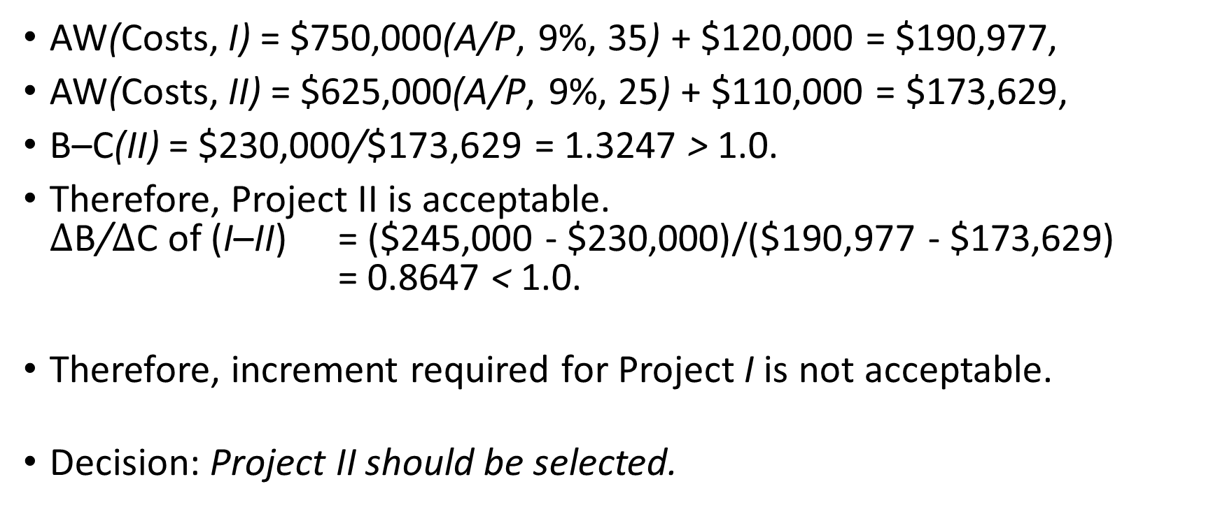
Example B−C Analysis with Unequal Project Lives
AW(Costs, I) = $750,000(A/P, 9%, 35) + $120,000 = $190,977,
AW(Costs, II) = $625,000(A/P, 9%, 25) + $110,000 = $173,629,
B–C(II) = $230,000/$173,629 = 1.3247 > 1.0.
Therefore, Project II is acceptable. $∆$B/$∆$C of (I–II) = ($245,000 - $230,000)/($190,977 - $173,629) = 0.8647 < 1.0.
Therefore, increment required for Project I is not acceptable.
Decision: Project II should be selected.

Slide 50
End of Chapter 10

